Slide 1
ANTARTICA
DEREK MAHON

Slide 2
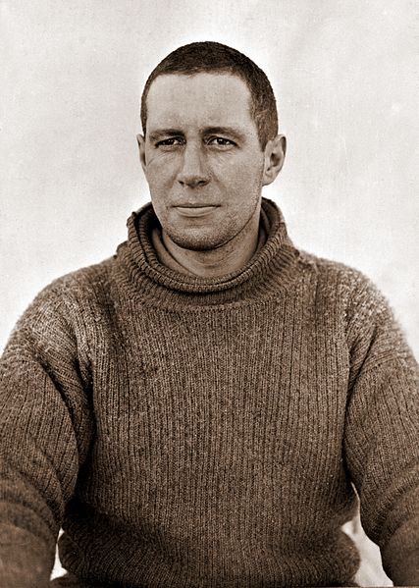
Background
1912
Lawrence Oates
His last words were;
‘I’m just going outside, I may be some time’

Slide 3
Form
Villanelle
19 line poem with 5 terects and a quatrain
The rhyming scheme is strict – only two rhyming patterns.
The form restricts the poets freedom, yet Mahon manages to convey emotion using simple language

Slide 4
‘I’m just going outside and may be some time’
A direct quote from Lawrence Oates
Repeated throughout
‘At the heart of the ridiculous, the sublime’
The reader is addressed and place in the poem
What is Mahon saying here?
What is Ridiculous?
What is Sublime?
Oates is described as a ‘Solitary enzyme’ Why?
His decision to leave may affect the fate of others but the fact that he is dying does not change

Slide 5
What is the purpose of repetition? Why does Mahon repeat certain phrases?
‘Goading his ghost into the howling snow
Assonance
Language
Repetition is used to reinforce or strengthen an idea or point of view by placing emphasis on it.
Mahon makes us focus on the fact that he[Oates] is leaving as well as the notion of:
1.The Ridiculous
2. The Sublime

